Slide 1


Slide 2

PERMUTATION AND COMBINATION 1.2

Slide 3
FORMULA
^{n}P_{r} = n! /(n-r)!
The number of object is “n”
Permutation is “P”
The selection of object to be “r”

Slide 4
How many numbers can be made with the digits 3, 4, 5, 6, 7, 8 lying between 3000 and 4000 which are divisible by 5 while repetition of any digit is not allowed in any number?
60
12
120
24
Notes:
Ans: B) 12

Slide 5
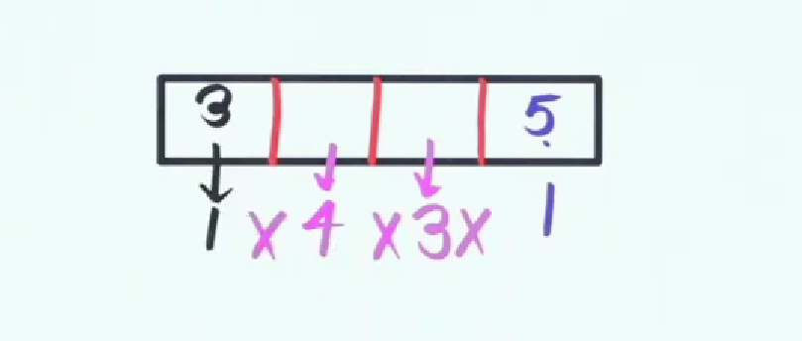
Answer

Slide 6
The number of 5 digit numbers which are divisible by 4, with digits from the set{1,2,3,4,5} and the repetition of digits is allowed, is ________?
625
500
600
525
Notes:
Ans: A) 625

Slide 7
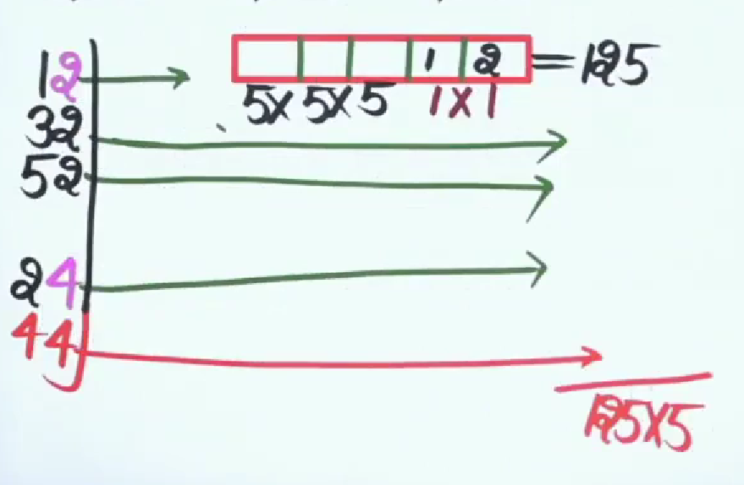
Answer

Slide 8
N is the total number of 5-digit numbers which are divisible by 4 and the numbers are formed using the digits 1, 2, 3, 4, 5 and 6. No digit is repeated in the number. What is the value of N?
144
162
NOT
192
Notes:
Ans: D) 192

Slide 9
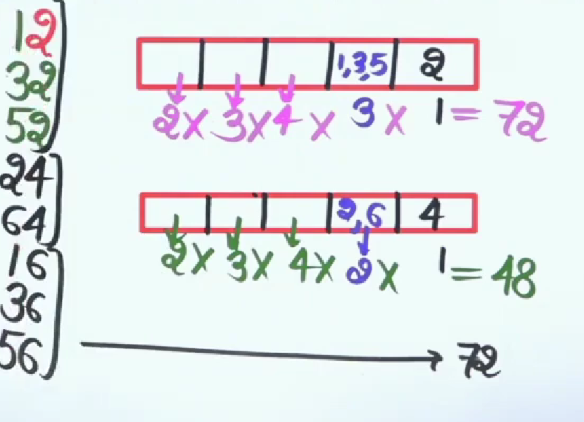
Answer

Slide 10
How many words can be framed by the letter of the word MANISH?
720
480
360
240
Notes:
Ans: A) 720

Slide 11
In how many ways letters of the word RUMOUR can be arranged?
180
720
360
90
Notes:
Ans : A) 180

Slide 12
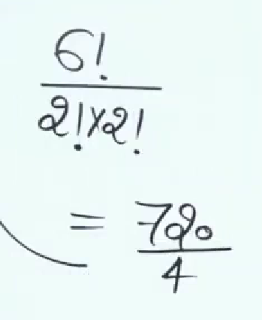
Answer

Slide 13
In how many ways can the letters of the word PERMUTATIONS be arranged if the words start with P and end with S?
12! / 2!
10! / 2!
8!
10!
Notes:
Ans: B) 10!/2!

Slide 14
Q1
The letters of the word 'INCOMPREHENSIBILITIES'
are arranged alphabetically in reverse order. How many
positions of the letter(s) will remain unchanged?
1. none
2. one
3. two
4. three
Notes:
Answer: 3
The given word is INCOMPREHENSIBILITIES.On arranging its letters alphabetically in reverse order,
we will get: TSSRPONNMLIIIIIHEEECB
Two I, I are at same position.

Slide 15
Q2
How many distinct 8-digit numbers can be formed by
rearranging the digits of the number 11223344 such that
odd digits occupy odd positions and even digits occupy
even positions?
1. 12
2. 18
3. 36
4. 72
Notes:
Answer: 3
The number 11223344 has 4 odd digits (1,1,3,3) and 4 even digits (2,2,4,4).
In an 8-digit number, there are 4 odd positions (1st, 3rd, 5th, 7th) and 4 even positions (2nd, 4th, 6th, 8th).
The 4 odd digits can be arranged in the 4 odd positions in 4!/2!2! = 6 ways
Similarly, the 4 even digits can be arranged in the 4 even positions in 4!/2!2! = 6 ways.
Therefore, the total number of distinct 8-digit numbers is 6 * 6 = 36.
So, the correct answer is (c) 36.

Slide 16
Q3
What is the sum of all 4-digit numbers less than 2000
formed by the digits 1, 2, 3, and 4, where none of the
digits is repeated?
1. 7998
2. 8028
3. 8878
4. 9238
Notes:
Answer: 1
The 4-digit numbers less than 2000 are formed by the digits 1, 2, 3, and 4
where none of the digits is repeated are 1234, 1243, 1324, 1342, 1423, and 1432.
Adding these numbers together gives the sum:
1234 + 1243 + 1324 + 1342 + 1423 + 1432 = 7998

Slide 17
Q4
What is the number of selections of 10 consecutive
things out of 12 things in a circle taken in the clockwise direction?
1. 3
2. 11
3. 66
4. 12
Notes:
Answer: 4
in circular permutation,
if we need to select 'n' number of things in a circle then the number of selection whatever number it may be that number will be the answer 'n' . Since there are 12 things in the circle, there are 12 possible starting points.
Therefore, there are 12 different ways to select 10 consecutive things out of 12 things in a circle.

Slide 18
Q5
There is a meeting of 20 delegates that is to be held in a
hotel. In how many ways can these delegates be seated
along a round table, if three particular delegates always
sit together?
1. 17! * 3!
2. 18! * 3!
3. 17! * 4!
4. 18! * 4!
Notes:
Answer: 1
circular permutation = (n-1)!
= 3 delegates always sits together = 1 group
= out of 20, 3 delegates gone remaining = 17 people
= total => 1+17 => 18 entities
= 3 delegates can arrange in = 3! ways
= (18-1)! * 3!
= 17! * 3!

Slide 19
Q6
Using 2, 2, 3, 3, 3 as digits, how many distinct numbers
greater than 30000 can be formed?
1. 3
2. 6
3. 9
4. 12
Notes:
Answer: 2
Digits available: 2,2,3,3,3 (two 2’s and three 3’s) – Number must be > 30000 – First digit must be 3 Step 1: Organize possible cases Case 1: First two digits are 33 Remaining digits: 2,2,3 Possible arrangements: 1. 33223 2. 33232 3. 33322 Case 2: First digit 3, second digit 2 Remaining digits: 2,3,3 Possible arrangements: 4. 32233 5. 32323 6. 32332 Step 2: List all numbers in ascending order 1. 32233 2. 32323 3. 32332 4. 33223 5. 33232 6. 33322

Slide 20
Q7
How many ways can a four-digit even number be formed by using the digit 2,3,5,8 exactly once?
1. 24
2. 12
3. 6
4. 18
Notes:
Ans: b
_ _ _ _ ➔ 3*2*1*2 = 12 ways
1st place ➔ 3 Possibility – (the last digit holds either 2 or 8, then the remaining 3 no. are the possibility)
2nd place ➔ 2 Possibility – (1st holds 1 no. and last place holds 1 no. remaining 2 possibility)
3rd place ➔ 1 Possibility – (other places hold each number then remaining no. will be possibility - 1)
Last place ➔ 2 (last no. even – 2,8 – so, 2 possibility)

Slide 21
Q8
If a refrigerator contains 12 cans such that 7 are blue and 5 are red, in how many ways can we remove 8 cans so that at least 1 blue and 1 red remain in the refrigerator?
1. 513
2. 455
3. 627
4. 369
Notes:
Answer: 2
The possible cases of (b,r) draw are (6,2) (5,3) (4,4) 6 2---->7c6*5c2--->7*10=70 5 3---->7c5*5c3--->21*10=210 4 4---->7c4*5c4--->35*5=175 70+210+175=455
or
* (4R,4B) or (3R,5B) or (2R,6B) => ncr = n! / r! * (n-r)! * 5c4 * 7c4 + 5c3 * 7c5 + 5c2 * 7c6
* 5*4!/4!*1! * 7*6*5*4!/4!*3! + 5*4*3!/3!*2! * 7*6*5!/5!*2! + 5*4*3*2!/2!*3! * 7*6!/6!*1! * 5 * 35 + 10 * 21 + 10 * 7 * 175 + 210 + 70 * 455

Slide 22
Q9
Out of 7 consonants and 4 vowels, how many words of 3
consonants and 2 vowels can be formed?
1. 24400
2. 21300
3. 210
4. 25200
Notes:
Answer: 4
Number of ways of selecting 3 consonants from 7= 7C3 Number of ways of selecting 2 vowels from 4= 4C2 Number of ways of selecting 3 consonants from 7 and 2 vowels from 4 = 7C3 × 4C2 =(7×6×5/3×2×1)×(4×3/2×1)=210 It means we can have 210 groups where each group contains total 5 letters (3 consonants and 2 vowels). Number of ways of arranging 5 letters among themselves=5!=5×4×3×2×1=120 Hence, required number of ways=210×120=25200

Slide 23
Q10
An intelligence agency forms a code of two distinct digits selected from 0-9 such that the first digit of the code is nonzero. The code, handwritten on a slip, can create confusion when read upside down (e.g., 91 may appear as 16). How many codes are there for which no such confusion can arise?
1. 80
2. 78
3. 71
4. 69
Notes:
Answer: 3
* the total possible code = 9 * 9 = 81 ways (1st never start with zero & for 2nd only remaining 9 option out of 10 option ). * eliminating confusing code (1,6,8,9) = 4 * 3 = 12 ways * 12 - 2 = 10 ways (here 69 & 96 will never create confusion) * 81 - 10 = 71 are non-confusing codes.

Slide 24
Q11
In how many ways can a batsman score exactly 25 runs by scoring singles, fours, and sixes only, irrespective of the sequence?
1. 18
2. 19
3. 20
4. 21
Notes:
Answer: 2
Let x = singles, y = fours, z = sixes We need to find integer solutions to: x + 4y + 6z = 25 Approach: Systematically consider possible values for z (sixes) from maximum to minimum. Solutions: z = 4: (1,0,4) → 1 way (four sixes and one single) z = 3: (7,0,3), (3,1,3) → 2 ways z = 2: (13,0,2), (9,1,2), (5,2,2), (1,3,2) → 4 ways z = 1: (19,0,1), (15,1,1), (11,2,1), (7,3,1), (3,4,1) → 5 ways z = 0: (25,0,0), (21,1,0), (17,2,0), (13,3,0), (9,4,0), (5,5,0), (1,6,0) → 7 ways Each tuple represents (singles, fours, sixes). Total number of ways: 1 + 2 + 4 + 5 + 7 = 19

Slide 25
Q12
Suppose you have a sufficient amount of rupee currency in three denominations: Rs.1, Rs.10, and Rs.50. In how many different ways can you pay a bill of Rs.107?
1. 15
2. 16
3. 17
4. 18
Notes:
Answer: 4
case 1: max. Rs. 50 => 1 ways (50 + 50 + 7 = 107).
case 2 : 1_ Rs. 50 => 6 ways ( [ i ] : 50 + 0 + 57 , [ ii ] : 50 + 1 + 47 , [ iii ] : 50 + 2 + 37 , [ iv ] : 50 + 3 + 27 , [ v ] : 50 + 4 +17 , [ vi ] : 50 + 5 + 7).
case 3 : max of Rs.10 => 11 ways.
therefore total number of ways is 1 + 6 + 11 = 18 ways.

Slide 26
Q13
Find the sum of all the 4-digit numbers that can be formed with the digits 3, 4, 5, and 6.
1. 119988
2. 11988
3. 191988
4. 198198
Notes:
Answer: 1
* we have 4 unique digits, the total number of permutations is 4! = 24. * Each digit will appear in each position (thousands, hundreds, tens, and units) exactly 24/4 = 6 times. * Sum of Digits: 3 + 4 + 5 + 6 = 18. * Contribution to Each Place Value: => For thousands place: 18×1000×6=108000 => For hundreds place: 18×100×6=10800 => For tens place: 18×10×6=1080 => For units place: 18×1×6=108 * Sum of All Contributions: * Total sum: 108000 + 10800 + 1080 + 108 = 119988

Slide 27
Q14
There are 15 points in a plane, out of which 6 are collinear. Find the number of lines that can be formed from these 15 points.
1. 105
2. 90
3. 91
4. 95
Notes:
Answer: 3
* the number of lines that can be formed from 15 points is equal to the number of distinct pairs of points that can be formed from these 15 points. * There are 15 points in total so the number of ways to select 2 points out of 15. * 15C2 = (15×14)/(2×1) = 105 * However, 6 of these points are collinear, meaning that any pair of points selected from this group of 6 points will not form a unique line. We must therefore subtract the number of pairs of points that can be formed from these 6 collinear points. *There are 6 points in this group, so the number of ways to select 2 points out of 6 is given by * 6C2 = (6×5)/(2×1) = 15 * Since these 6 points form only 1 line, we subtract the 14 extra lines: * 105 - 14 = 91

Slide 28
Question :
A basket contains 10 apples and 20 oranges out of which 3 apples and 5 oranges are defective. If we choose two fruits at random, what is the probability that either both are oranges or both are non-defective?
○ 127/327
○ 217/483
○ 316/435
○ 217/258
Notes:
Ans: c
Total favourable condition = 30c2
P(a) = 20c2/30c2
P(b) = 22c2/30c2
P(a b) = 15c2/30c2
P(a b) = p(a)+p(b)-p(a b)
= 20c2/30c2 + 22c2/30c2 - 15c2/30c2
= 190 / 435 + 231/435 – 105/435
= 316/435

Slide 29
Question :
Eleven books, consisting of five Engineering books, four Mathematics books, and two Physics books, are arranged on a shelf at random. What is the probability that the books of each kind are all together?
○ 5/1155
○ 3/1155
○ 2/1155
○ 1/1155
Notes:
Ans:
Total no. of books = 5+4+2 =11
11 books arranged in 11! Ways
If we want to keep same subject books together, then no. ways of arranging them subject wise = 3!
Maths = 5!
Physics = 4!
Chemistry = 2!
Total no. of desired event = 2!*3!*4!*5!
Required probability,
2!*3!*4!*5! / 11! =1/ 1155

Slide 30
Q15
How many integers greater than 999 but not greater than 4000 can be formed with the digits 0, 1, 2, 3, and 4, if repetition of digits is allowed?
1. 376
2. 360
3. 420
4. data inadequate
Notes:
Answer: 1
The first digit is 1000, a 4 digit number. And the last digit = 4000. The only 4-digit numbers to start with 4. Therefore there are four digits in each integer,and first digit can be 1,2 and 3. Second, third and fourth can be 0,1,2,3 and 4 i.e. ways. So total ways = 3×5×5×5 = 375+1 for 4000 = 376

Slide 31
Question
How many numbers greater than 0 and less than a million can be formed with the digits of 0, 5, and 7? (repetition allowed)
○ 486
○ 1086
○ 728
○ 568
Notes:
ANS: 728
Possible Digit Counts:
Since the numbers must be less than a million, they can have 1, 2, 3, 4, 5, or 6 digits.
Number of Choices per Digit:
For the first digit, we can only use 5 or 7 (2 choices).
For all other digits, we can use 0, 5, or 7 (3 choices).
Calculation:
1-digit numbers: 2
2-digit numbers: 2 * 3 = 6
3-digit numbers: 2 * 3 * 3 = 18
4-digit numbers: 2 * 3 * 3 * 3 = 54
5-digit numbers: 2 * 3 * 3 * 3 * 3 = 162
6-digit numbers: 2 * 3 * 3 * 3 * 3 * 3 = 486
Total:
2 + 6 + 18 + 54 + 162 + 486 = 728

Slide 32
Question
If there are five trains from P to Q and 2 trains from Q to R, in how many ways can one travel from P to R by train? (assume there are no direct trains from P to R)
○ 5
○ 8
○ 10
○ 15
Notes:
ANS: 10
P to Q: You have 5 different train choices.
Q to R: You have 2 different train choices.
To travel from P to R, you need to:
Choose a train from P to Q.
Choose a train from Q to R.
Since these choices are independent, you multiply the number of options together:
Total ways = (Number of trains from P to Q) * (Number of trains from Q to R)
Total ways = 5 * 2 = 10
Therefore, there are 10 ways to travel from P to R by train.

Slide 33
Question
There are 7 fans in a hall and each one of them can be switched on independently. Find the total number of ways in which the fans can be turned on.
○ 2^7
○ 127
○ 10^7
○ 7^2
Notes:
ANS: 2^7
Each fan has 2 states: It can be either "on" or "off".
Independent Fans: Since each fan can be switched on independently, the state of one fan doesn't affect the others.
Total Possibilities: For each fan, there are 2 possibilities. Since there are 7 fans, the total number of ways is 2 multiplied by itself 7 times.
Total ways = 2 * 2 * 2 * 2 * 2 * 2 * 2 = 2⁷ = 128

Slide 34
Question
A number lock on a suitcase has 3 wheels each labeled with 10 digits from 0 to 9. If the opening of the lock requires a particular sequence of three digits with no repeats, how many such sequences will be possible?
○ 4224
○ 720
○ 560
○ 5040
Notes:
ANS: 720
Wheel 1: You have 10 choices (0 through 9).
Wheel 2: Since you can't repeat digits, you have 9 choices left.
Wheel 3: You now have 8 choices left.
To find the total number of possible sequences, you multiply the number of choices for each wheel:
Total sequences = 10 * 9 * 8 = 720
There are 720 possible sequences.

Slide 35
Question
A question paper contains 15 'true or false' questions. In how many ways can a candidate answer the entire paper? Assume that the candidate answers all the questions.
○ 2^10
○ 3^15
○ 2^15
○ 3^15
Notes:
ANS: 2^15
Each question has 2 options: True or False.
Independent Questions: The answer to one question doesn't affect the others.
Total Possibilities: For each question, there are 2 possibilities. Since there are 15 questions, the total number of ways is 2 multiplied by itself 15 times.
Total ways = 2 * 2 * 2 * ... (15 times) = 2¹⁵ = 32768
There are 32,768 ways a candidate can answer the paper.

Slide 36
THANK YOU

